Slide 1
SAFE BOOT Options
Safe Mode Is A Special Way For Windows To Load When There Is A System-critical Problem That Interferes With The Normal Operation Of Windows.
The purpose of Safe Mode is to allow you to troubleshoot Windows and try to determine what is causing it to not function correctly.
Once you have corrected the problem, then you can reboot and Windows will load normally.

Slide 2
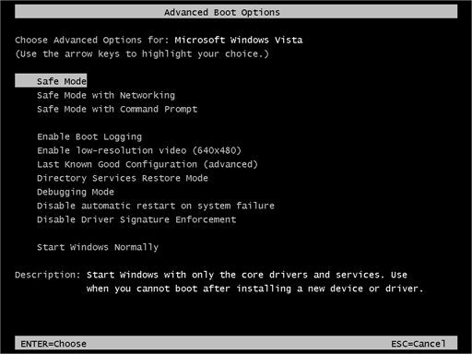
SAFE Modes
Safe Mode starts Windows with only core drivers and services.
Safe Mode with Networking starts windows with only core drivers, plus networking support.
Safe Mode with Command Prompt is identical to Safe Mode except that Command Prompt is loaded as the default user interface instead of Explorer. Choose Safe Mode with Command Prompt if you've tried Safe Mode but the taskbar, Start screen, or Desktop doesn't load properly

Slide 3
Steps to be followed to enter safe mode
Immediately after the computer is powered on or restarted (usually after you hear your computer beep), tap the F8 key in 1 second intervals.
After your computer displays hardware information and runs a memory test, the Advanced Boot Options menu will appear.
Use the arrow keys to select Safe Mode or Safe Mode with Networking and press ENTER.
When you are finished troubleshooting, repeat steps 1-3 and select Start Windows Normally to return to your normal Windows configuration.

Slide 4
There are several things that happen when Windows boots in Safe Mode
Safe Mode does not run the autoexec.bat or config.sys files.
Most device drivers are not loaded.
Instead of the normal graphics device driver, Safe Mode uses standard VGA graphics mode. This mode is supported by all Windows-compatible video cards.
Himem.sys, which is normally loaded as part of the config.sys script, is loaded with the /testmem:on switch. This switch tells the computer to test the extended memory before continuing.
Safe Mode checks the msdos.sys file for information on where to find the rest of the Windows files. If it finds the files, it proceeds to load Windows in Safe Mode with the command win /d:m. If it does not find the Windows files, it will run command.com to bring up a C: prompt.

Slide 5
Windows boots using a batch file called system.cb instead of the standard system.ini file. This file loads the Virtual Device Drivers (VxDs) that Windows uses to communicate with the standard parts of the computer.
Windows now loads the regular system.ini file plus win.ini and Registry settings. It skips the [Boot] (except for the shell and device lines) and [386Enh] sections of system.ini and does not load or run any programs listed in win.ini.
The Windows desktop loads up in 16 colors and at a resolution of 640 x 480 with the words "Safe Mode" in each corner.

